Slide 1
Chapter 3
Strategic Management
Jeff Dyer
Second Edition
Internal Analysis: Strengths, Weaknesses, and Competitive Advantage

Slide 2
Technical innovations
Flowers and Trees—the first cartoon to use 3 color Technicolor technology, 1932
Snow white—the first full length feature in 1937
Fantasia—1940, the first film in stereophonic sound

Slide 3
Huge innovation, huge risk
Disneyland
The Happiest Place on Earth

Slide 4
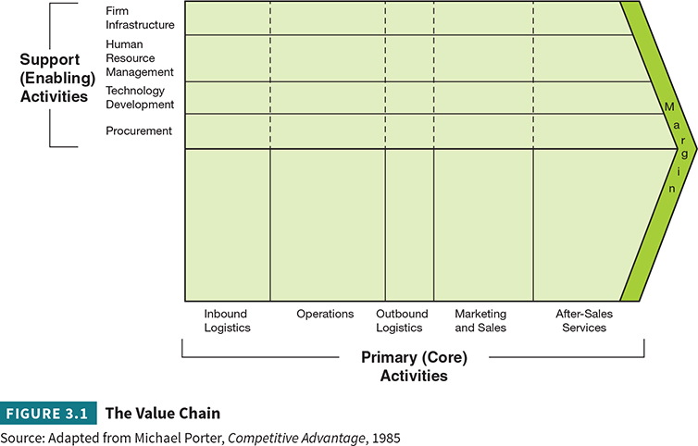
The Value Chain
Value Chain- A visual description of the steps required to turn raw materials into finished products and/or services. The value chain also describes key functions of
the firm linked to each stage and functions that span the productive activities of the firm.

Slide 5
The Resource-Based View
Resources- All assets, capabilities, organizational processes, firm attributes, information, knowledge, and so on, controlled by a firm that enable the firm to conceive of and implement strategies that improve its efficiency and effectiveness.
Assets- Tangible or intangible resources or factors of production that create economic value for the firm when employed.
Four categories of resources are important contributors to competitive advantage:
Physical Resources
Financial Resources
Human Resources
Intangible Resources

Slide 6
The Resource-Based View (continued)
Capabilities- The procedures, processes, and routines firms employ in their activities.
Operating Capabilities- Procedures, processes, or routines for delivering value to customers, employees, suppliers, or investors.
Dynamic Capabilities- Procedures, processes, and routines that continuously expand existing resources or improve operating capabilities.
Priorities- A firm’s values and rankings of what is most important.

Slide 7
CREATING A SUSTAINABLE COMPETITIVE ADVANTAGE: VRIO MODEL
Value- Worth or utility.
Rarity- To be uncommon, or not available to other competitors.
Inimitability- An attribute of a resource that describes the degree of difficulty a competitor would face in copying, imitating, or mimicking the value of that resource
Positive Network Externalities- When the value of a product increases with the number of users.
Virtuous Circle- When more sellers attract more buyers, who, in turn, attract more sellers.
Organized to Exploit- The degree to which the legal, administrative, and operating structure of the firm allows it to capture the rents generated by resources.

Slide 8
Example: Inimitable Resources
Unique History—Coke
Path Dependence—Boeing
Complex Systems—Merck
Tacit Knowledge—Apple
Property Rights—Chevron

Slide 9
Assessing Competitive Advantage with VRIO
Competitive Failure- When firms that can’t create value for their stakeholders don’t survive.
Competitive Parity- When a company survives but has no real competitive advantage over rivals.
Sustained Competitive Advantage- When firms combine the legal elements, intellectual property rights, administrative elements, and cultural elements,
allowing them to capture high profits that come from their valuable, rare, and inimitable resources, capabilities, or priorities.

Slide 10
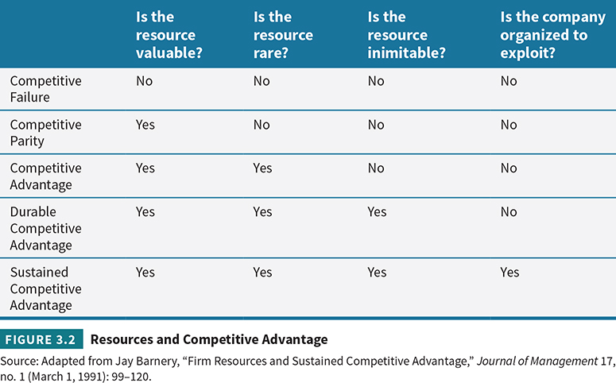
VRIO

Slide 11
Disney’s competitive advantage
Create content that drives repeat business
Managers can easily forget resources
Growth and expansion will always threaten the core

Slide 12
Today’s Activity Map?
Miramax |  |  |  | ESPN
Lucas Film | Pixar | Walt Disney | ESPN Zone | ESPN Deportes
Disneyland | Disney Cruise Line |  |  | 710am ESPN
Walt Disney World Resorts |  |  | ABC | Disney Channel The History Channel

Slide 13
The Company Diamond
Resources
The things we do to compete
Strengths & Weaknesses
(Activities)
The assets we employ
&
The processes we use
Capabilities
Priorities
The values that guide us

Slide 14
Gathering Data for Company Diamond Analysis
Data to complete a diamond profile come from a number of sources. You can use three main types of data:
Archival Data
Interviews
Observations

Slide 15
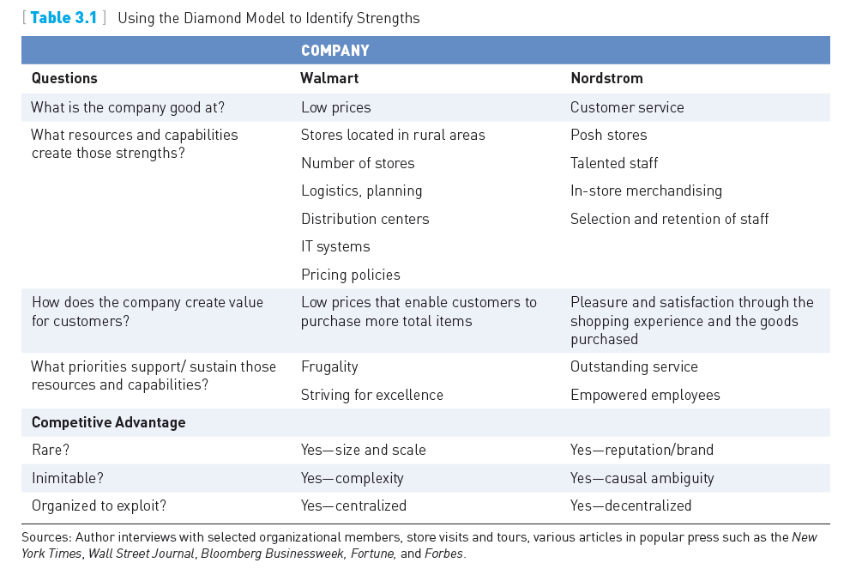
Using the Diamond Model

Slide 16
Class Activity: Creating a Company Diamond
Resources
The things we do to compete
Strengths & Weaknesses
(Activities)
The assets we employ
&
The processes we use
Capabilities
Priorities
The values that guide us

Slide 17
Copyright
Copyright © 2018 John Wiley & Sons, Inc.
All rights reserved. Reproduction or translation of this work beyond that permitted in Section 117 of the 1976 United States Act without the express written permission of the copyright owner is unlawful. Request for further information should be addressed to the Permissions Department, John Wiley & Sons, Inc. The purchaser may make back-up copies for his/her own use only and not for distribution or resale. The Publisher assumes no responsibility for errors, omissions, or damages, caused by the use of these programs or from the use of the information contained herein.

Slide 18
Copyright
Copyright © 2018 John Wiley & Sons, Canada, Ltd.
All rights reserved. Reproduction or translation of this work beyond that permitted by Access Copyright (The Canadian Copyright Licensing Agency) is unlawful. Requests for further information should be addressed to the Permissions Department, John Wiley & Sons Canada, Ltd. The purchaser may make back-up copies for his or her own use only and not for distribution or resale. The author and the publisher assume no responsibility for errors, omissions, or damages caused by the use of these programs or from the use of the information contained herein.

